Slide 1

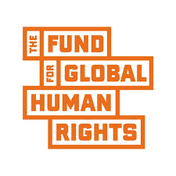
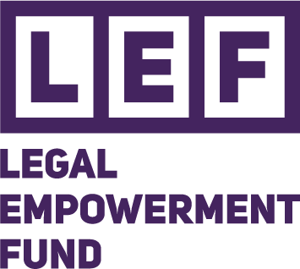
COMMUNITY CLIMATE
JUSTICE SCORECARD
From awareness to accountability; legal empowerment strategies to advance climate and environmental justice in Sierra Leone
Koya · Macdonald · Bureh Town · Fogbo · Lakkah | Western Area Rural District, Sierra Leone
Supported by the Legal Empowerment Fund, through the Fund for Global Human Rights

Slide 2




Five communities. One demand: justice.
Baseline evidence (2025) exposed a common pattern across Western Rural District: communities bearing the cost of environmental harm, with little power to hold anyone accountable for it.
Deforestation & Logging
Industrial Pollution
Coastal Erosion & Sand Mining
Weak Legal Enforcement
Koya, Fogbo
Koya, Macdonald
Bureh Town, Lakkah
All 5 communities
The common driver named by communities themselves: corporations and government actors, not the communities who live with the consequences.

Slide 3

How we score: one scale, every community
Every indicator — knowledge, participation, enforcement, accountability — is scored 1 to 5, so progress (or its absence) is comparable across communities and over time.
1
2
3
4
5
Very Weak
Weak
Developing
Good
Excellent
No progress; systemic failure
Minimal, isolated progress
Mixed results, not yet consistent
Consistent, mostly functional
Sustained, well-established

Slide 4

Legal literacy has more than doubled
Average community knowledge of environmental & climate laws, across all five communities (0-10 scale)
BASELINE (2025)
CURRENT (2026)
3.4
8.2
out of 10
out of 10
Every one of the five communities improved — proof that legal empowerment engagement works, and the case for scaling it further.

Slide 5

Progress, community by community
Koya
Macdonald
Bureh Town
Fogbo
Lakkah
Deforestation & industrial pollution
Industrial pollution (CRSG)
Sand mining & coastal erosion
Deforestation & waste pollution
Stone & sand mining
Baseline
Baseline
Baseline
Baseline
Baseline
1.6
2.5
2.0
2.3
2.1
Current
Current
Current
Current
Current
3.3
3.7
3.2
4.0
3.4
avg. score / 5
avg. score / 5
avg. score / 5
avg. score / 5
avg. score / 5

Slide 6

The number that hasn't moved
3 of 5
Macdonald
Complaints rose sharply as satisfaction with authority response stayed Low
Bureh Town
communities still rate environmental law enforcement as WEAK; unchanged since the 2025 baseline.
Sand mining and erosion continue unabated despite growing awareness
Lakkah
By-laws strengthened locally, but enforcement from authorities remains Weak

Slide 7
Named. Rated. Not yet held accountable.
Two companies were repeatedly named by communities during baseline and follow-up interviews. Scores below reflect community-reported experience.
Odhav Multi Industries
China Railway Seventh Group
KOYA
MACDONALD
1
Corporate social responsibility
1
Corporate social responsibility
No visible community development reported after years of operation
Reported failure to meet CSR obligations
2
Environmental compliance
1
Environmental compliance
Noise pollution repeatedly cited as unresolved
Linked to water contamination, waste pollution, structural damage
2
Responsiveness to complaints
Formal complaint filed with SLRSA; satisfaction remains Low

Slide 8

Every community moved forward
Average governance score (1-5) across all scored indicators, baseline vs. current

Slide 9

Who else needs to be at the table
Local Councils / District Authorities
2 / 5
Enforcement rated Weak across 4 of 5 communities
Odhav Multi Industries (Koya)
1-2 / 5
Weak CSR delivery and unresolved noise pollution
China Railway Seventh Group (Macdonald)
1-2 / 5
Weak CSR, environmental compliance and complaint response
SLRSA
Pending
Complaint lodged by Macdonald community; response awaited
EPA - Sierra Leone
Pending
Not yet directly engaged — recommended for next scoring round

Slide 10


What we're asking for
Enforce, don't just legislate
Corporate accountability
Duty-bearers must act on the National Environmental Protection Act and Forestry Act, not just acknowledge them.
Odhav Multi Industries and China Railway Seventh Group must meet CSR obligations and respond to complaints.
Institutionalise the scorecard
Resource what's working
Re-score every 6-12 months and use it as the standing basis for interface meetings with duty-bearers.
Fund the coordination teams and by-laws communities have already built, especially for youth and women.

Slide 11
Accountability is the next chapter.
Youth Partnership for Peace and Development (YPPD)
Legal Empowerment Strategies to Advance Climate and Environmental Justice
Supported by the Legal Empowerment Fund, through the Fund for Global Human Rights

